Slide 1

km
Sprocket Central Pty Ltd

Slide 2
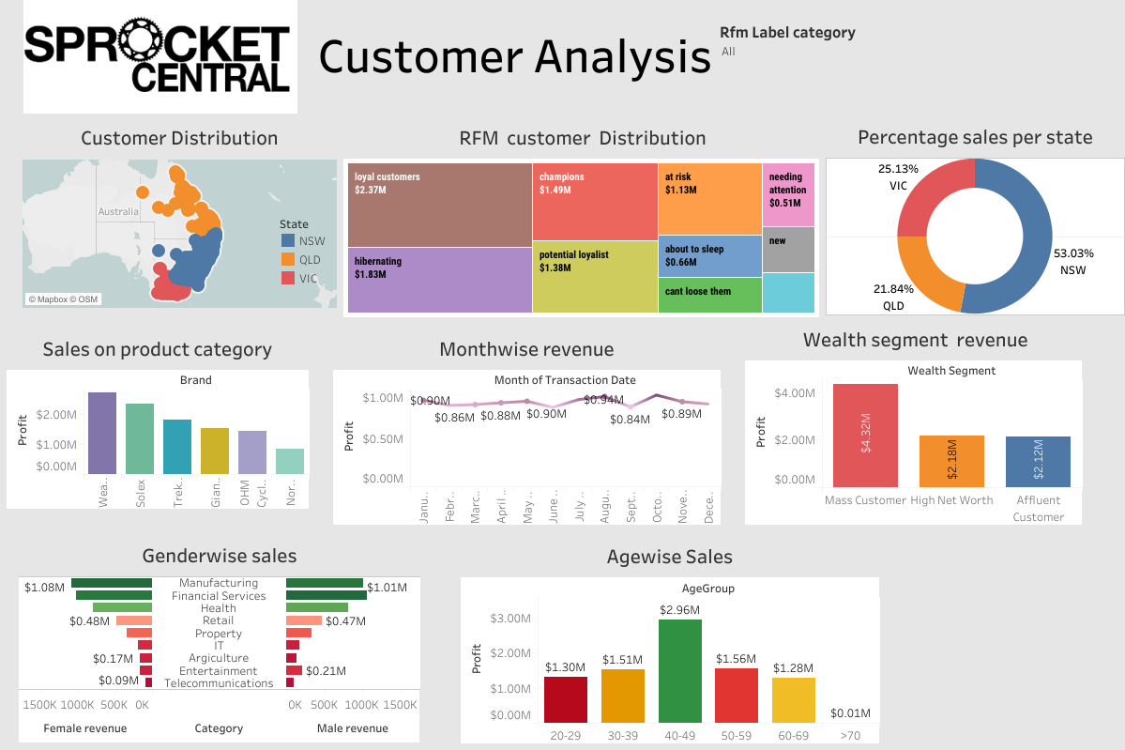

Slide 3
Customer Segment​ | Description​ | Retention Strategies​
Loyal Customers​ | Valuable segment that accounts for around half of all customers. Highly engaged and likely to make repeat purchases.​ | Provide excellent customer service, personalized offers, and rewards programs.​
Potential Loyalists​ | Similar to loyal customers, highly engaged and likely to make repeat purchases.​ | Provide excellent customer service, personalized offers, and rewards programs.​
Champions​ | Highly profitable customers, highly loyal to the brand.​ | Give special treatment such as exclusive offers, early access to new products, and personalized communication.​
Hibernating​ | Customers that the company has lost touch with.​ | Reactivate through a personalized outreach strategy, such as special offers, win-back incentives, and personalized communication.​
At-risk​ | Recent customers who have not engaged with the brand as much as before.​ | Offer personalized recommendations, incentivize repeat purchases, and offer loyalty rewards to keep them engaged.​
Potential​ | Customers who have made one or two purchases but have not demonstrated a strong attachment to the brand.​ | Target with personalized communication, special offers, and incentives to encourage them to make repeat purchases.​

Slide 4
Existing customers
​
Customer Distribution
Currently, all customers of Sprocket Central are located on the East Coast of Australia, with the majority in New South Wales and Queensland. Although there are fewer customers in Victoria, it is still a good market to continue to develop in the future.
As shown on the map, there are no customer records in the South, West, and North territories of Australia. According to the Australian Bureau of Statistics (2022), the total population of the South and West regions of Australia is about 18%, which presents a potential opportunity to expand the business.
RFM label is used as a category for tableau visualization
​
Target new customers criteria ​
​
State : NSW ​
Wealth segment: Mass customers​
Age group: 40-70
Gender : Female ​
Job sector: Financial sector ​
Brand : Solex band in standard product line and a medium product class.​
​

